Slide 1


Jenkins
Title: Overview of Jenkins
beCloudReady

Slide 2
Agenda
What is Continuous Integration?
Why do we need it?
Different phases of adopting Continuous Integration

Slide 3
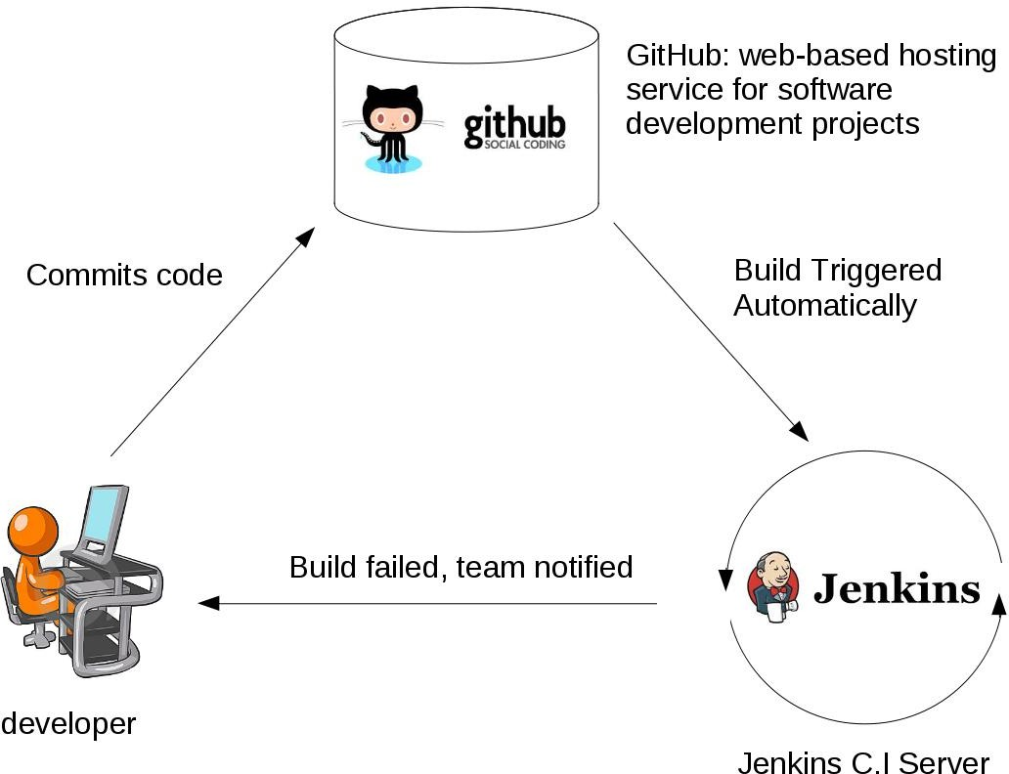
What is CI
What is Continuous Integration?
Developers commit code to a shared repository on a regular basis.
Version control system is being monitored. When a commit is detected, a build will be triggered automatically.
If the build is not green, developers will be notified immediately.

Slide 4
Why CI and CD
Detect problems or bugs, as early as possible, in the development life cycle.
Since the entire code base is integrated, built and tested constantly , the potential bugs and errors are caught earlier in the life cycle which results in better quality software.

Slide 5
Continuous Integration Steps – Build Automation
Automated builds are scheduled on a regular basis or even driven
Build script compiles the
application and runs a set of automated tests.
Developers now commit their
changes regularly.
Build servers would alert the
team members in case of build failure.

Slide 6
CI Steps – Build Trigger
A build is triggered whenever new code is committed to the central repository.
A build is triggered whenever new code is committed to the central repository.

Slide 7
CI Steps – Test Automation
Automated code quality and code coverage metrics are now run along with unit tests to continuously evaluate the code quality.
Build, run code quality and code coverage metrics along with tests

Slide 8
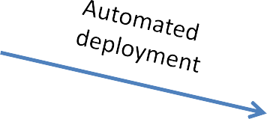
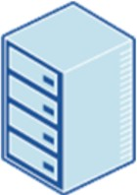
CI Step – Deployment or Continuous Delivery
Production

Slide 9
CI and CD in one Glance
Continuous Integration
The practice of merging development work with the main branch constantly.
Continuous Delivery
Continual delivery of code to an environment once the code is ready to ship. This could be staging or production. The idea is the product is delivered to a user base, which can be QAs or customers for review and inspection.
Continuous Deployment
The deployment or release of code to production as soon as it is ready.

Slide 10
Jenkins Installation - Jenkins Prerequisites
Jenkins requires minimum Java 7 to be installed.
It’s recommended to install Java 8.
NOTE: Currently Java 9 is NOT supported for this course due to some Jenkins plugin incapability issues.

Slide 11
Jenkins Installation - Environment Setup
JAVA_HOME environment variable points to the installation path for the Java Development Kit.
It is required by other applications which use Java.
If you are using Mac, you can follow this lecture to configure JAVA_HOME.
If you are using Windows or Linux, you can skip this lecture and follow the guide on the next text lecture.

Slide 12
Jenkins Installation -- Linux
sudo yum install epel-release
sudo yum install java-1.8.0-openjdk.x86_64
java -version
sudo cp /etc/profile /etc/profile_backup
echo 'export JAVA_HOME=/usr/lib/jvm/jre-1.8.0-openjdk' | sudo tee -a /etc/profile
echo 'export JRE_HOME=/usr/lib/jvm/jre' | sudo tee -a /etc/profile
source /etc/profile
cd ~
sudo wget -O /etc/yum.repos.d/jenkins.repo https://pkg.jenkins.io/redhat-stable/jenkins.repo
sudo rpm --import https://pkg.jenkins.io/redhat-stable/jenkins.io.key
yum install jenkins
sudo systemctl start jenkins.service
sudo systemctl enable jenkins.service
http://localhost:8080

Slide 13
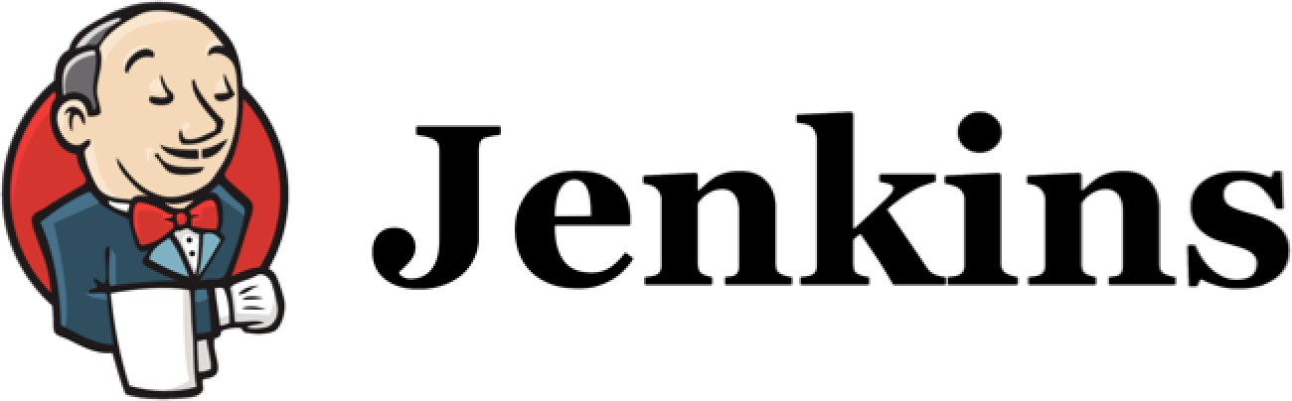
Hello world Jenkins
Creating first job

Slide 14
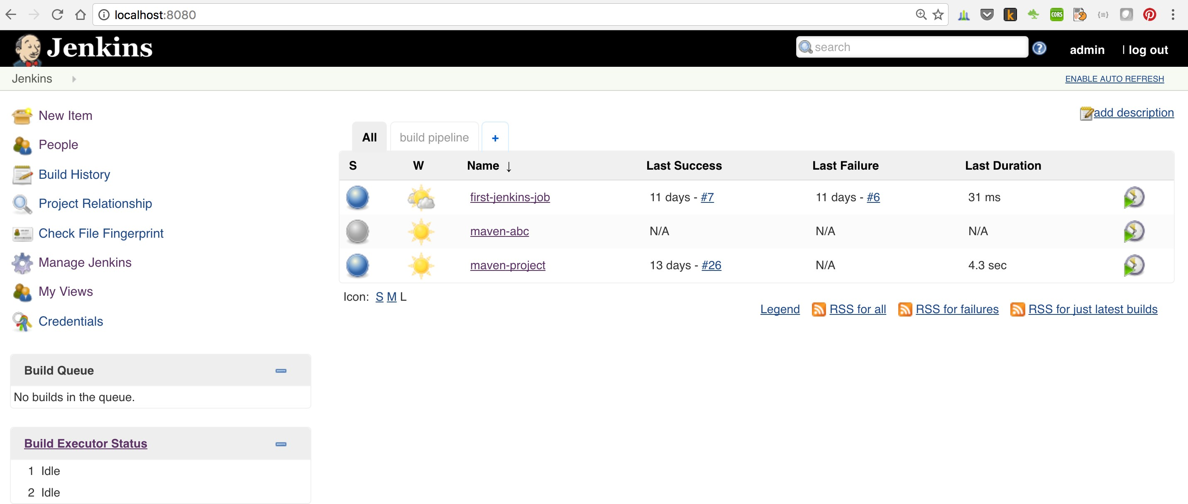
Jenkins Dashboard
Notes:
Do installation of Jenkins and create the first job

Slide 15
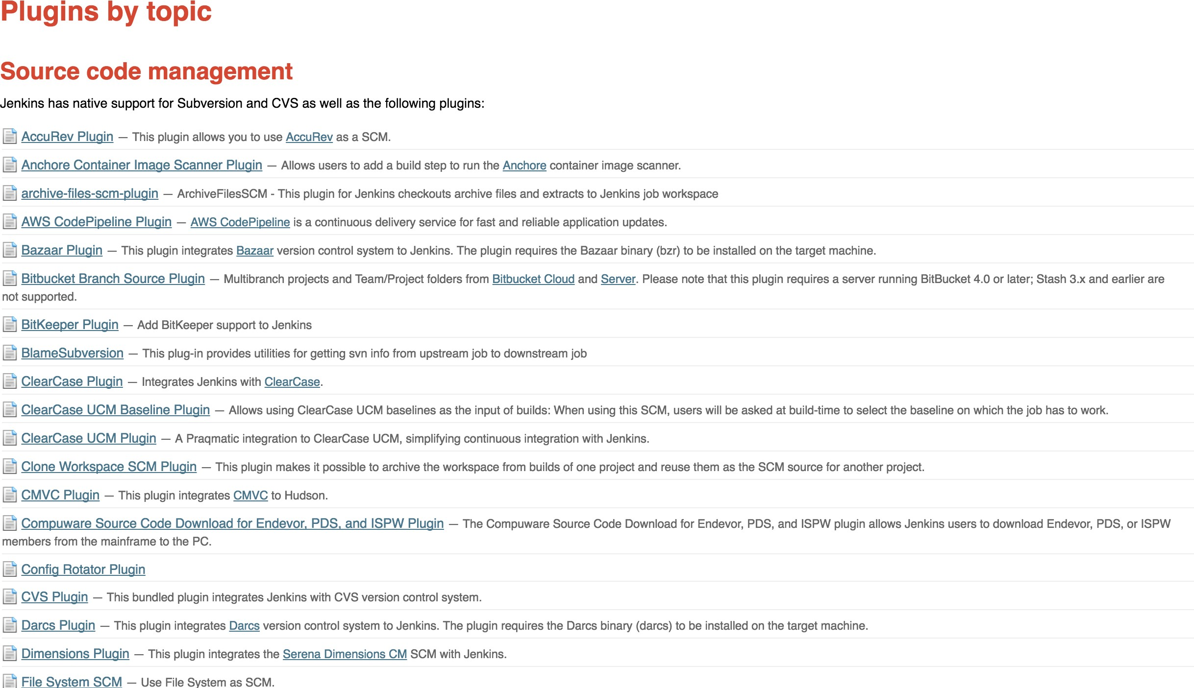
Power of Jenkins

Slide 16
Building with Jenkins -- Maven
Maven is an Apache Project
Maven is the JAVA build tool, which can handle complex software dependencies such like yum.
Maven describes how the software is built.
Maven describes the project’s dependencies.
Majority Java applications are build using maven such as Hadoop
Other Popular tools
Gradle
Ant

Slide 17
Building with Jenkins – Maven POM file
POM is a XML format file
Describe the software project being built, including
The dependencies on other external modules.
The directory structures.
The required plugins.
The predefined targets for performing certain tasks such as compilation and packaging.
Example of POM file: https://maven.apache.org/guides/introduction/introduction-to-the-pom.html#Super_POM

Slide 18
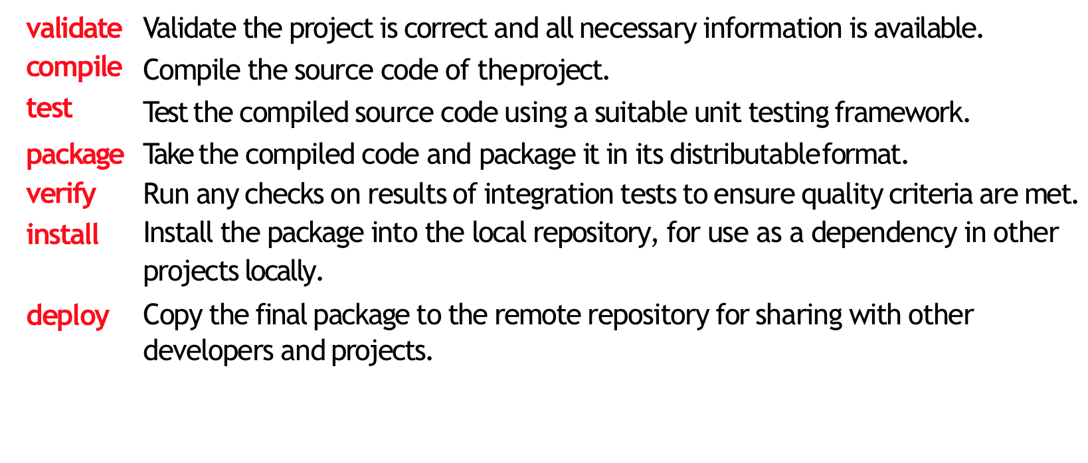
Building with Jenkins – Maven stages

Slide 19
Building with Jenkins – Maven Phases
These lifecycle phases are executed sequentially to complete the default lifecycle.
We want to specify the maven package command, this command would execute each default life cycle phase in order including validate, compile, test before executing package.
We only need to call the last build phase to be executed.

Slide 20

Continuous Integration with Ansible

Slide 21
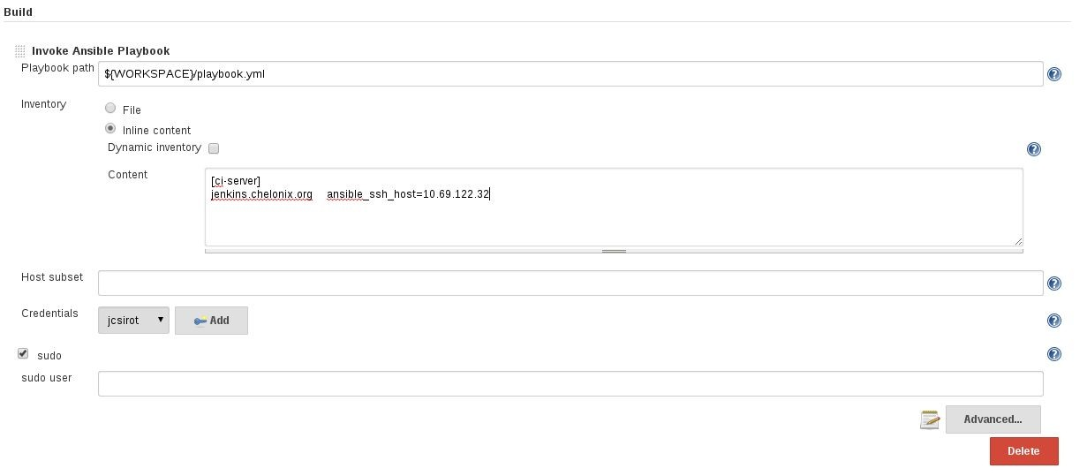
Jenkins Ansible Plugin
https://wiki.jenkins-ci.org/display/JENKINS/Ansible+Plugin

Slide 22
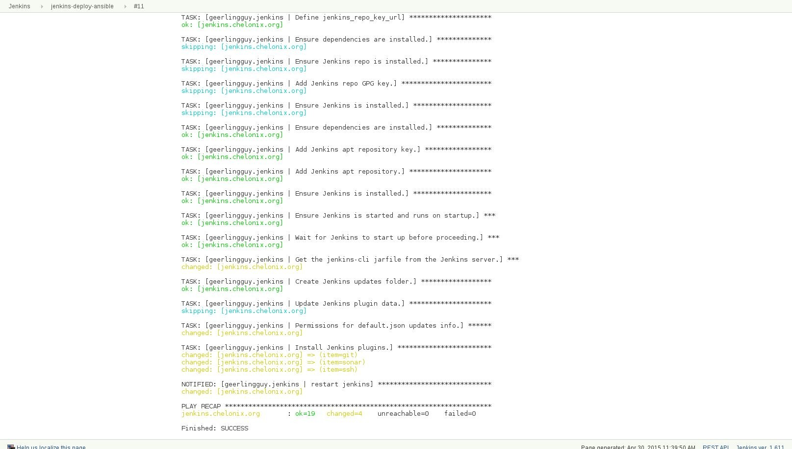
Jenkins Ansible Plugin

Slide 23
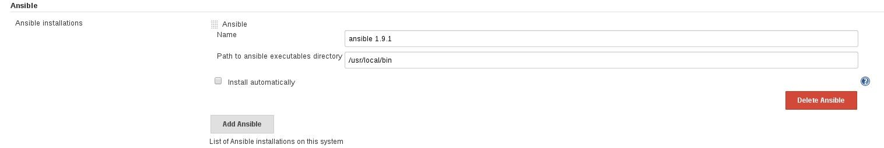
Jenkins Ansible Plugin

